Slide 1
FULLSTACK
Backend Programming

Slide 2
Pointer

Slide 3
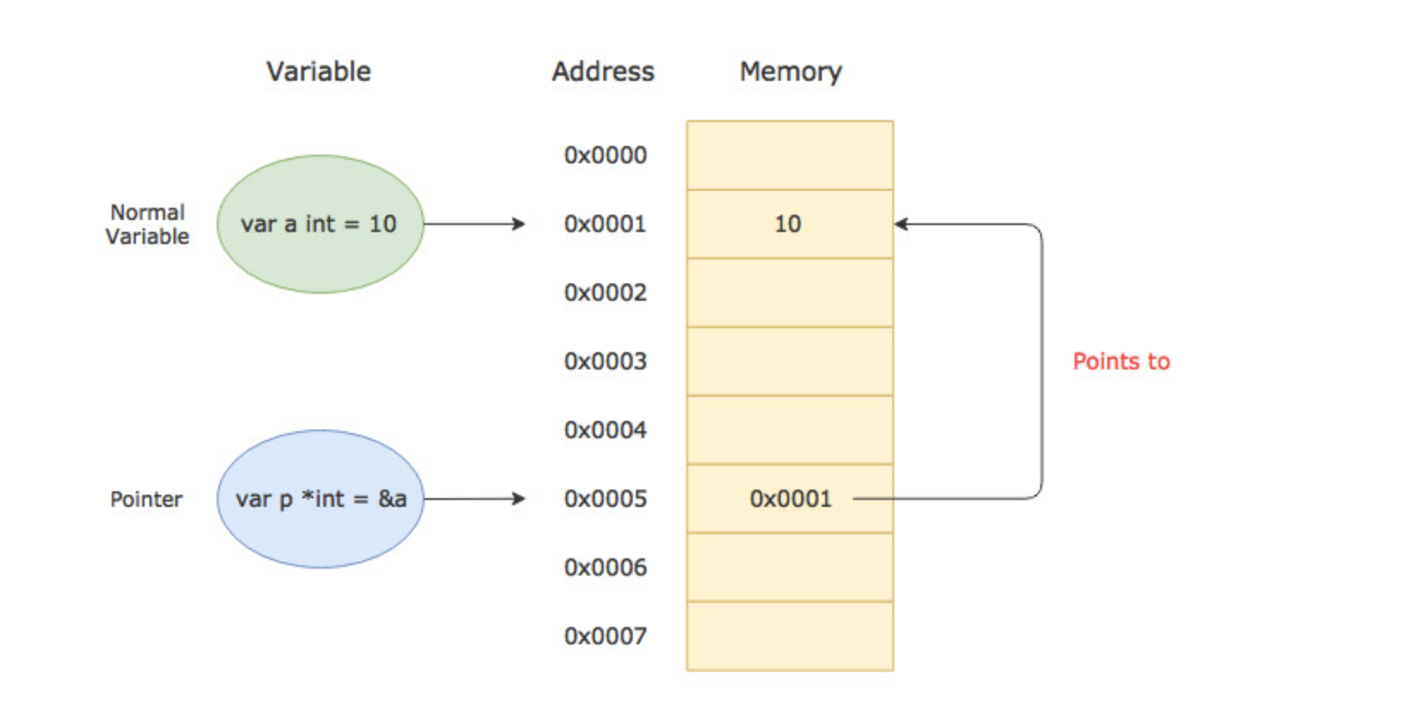
Pointer

Slide 4
Pointer
Pointer is a reference or memory address
For example : var a *int = 10 The memory address is 10. It’s not only value by itself.

Slide 5
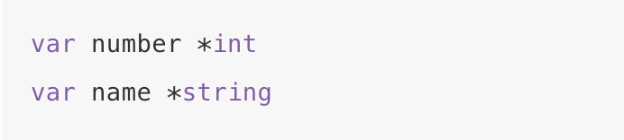
Pointer - Declaration

Slide 6
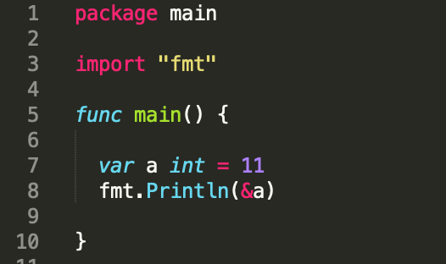
Pointer
Each variable is a memory location
Each memory location has its address defined which can be accessed using ampersand (&) operator, which denotes an address in memory.

Slide 7
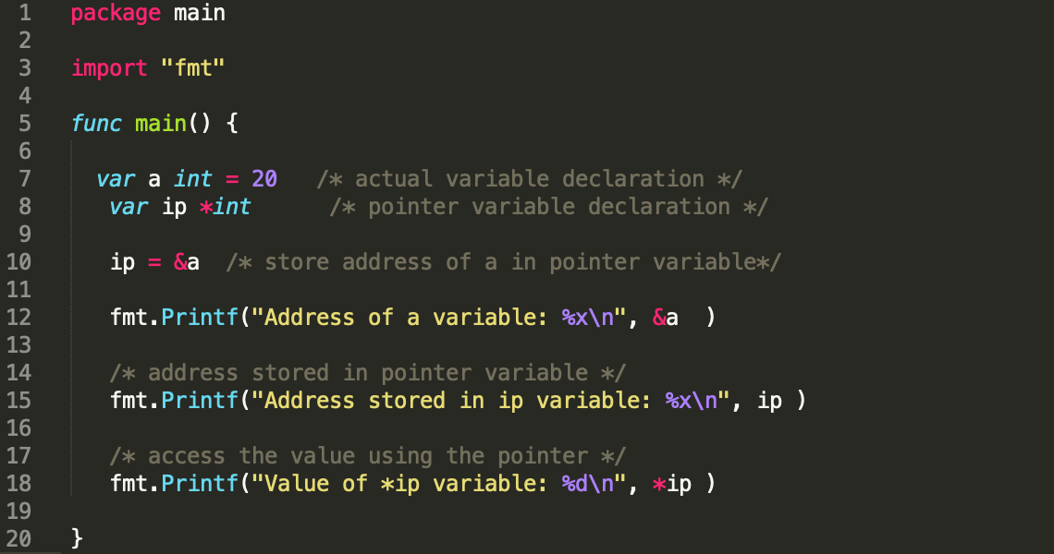
Pointer

Slide 8
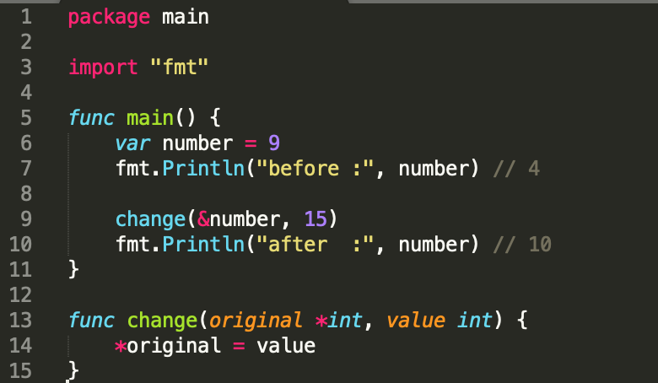
Pointer - Parameter
Parameter can be designed as pointer

Slide 9
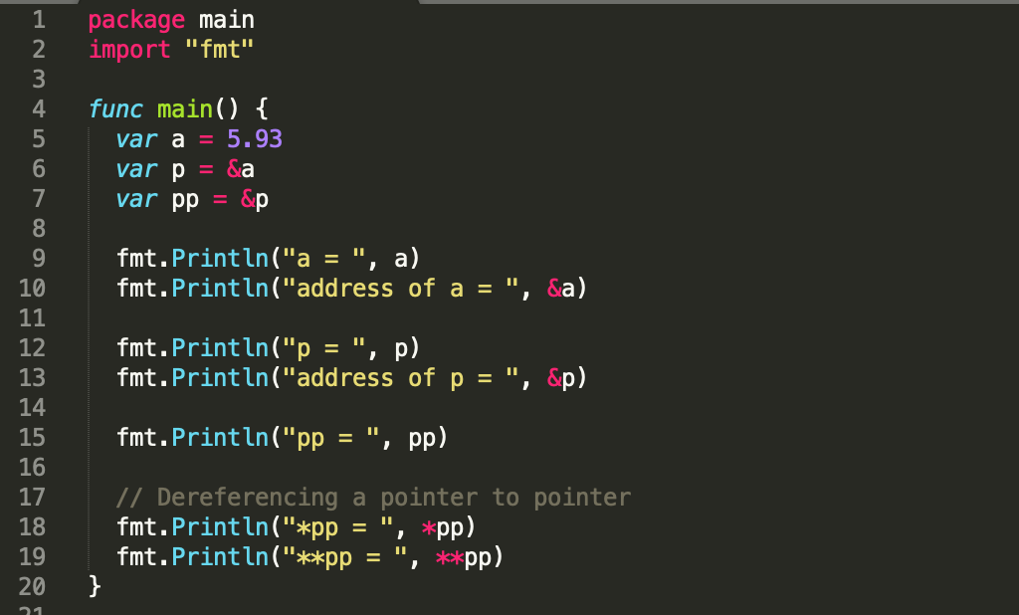
Pointer to Pointer

Slide 10
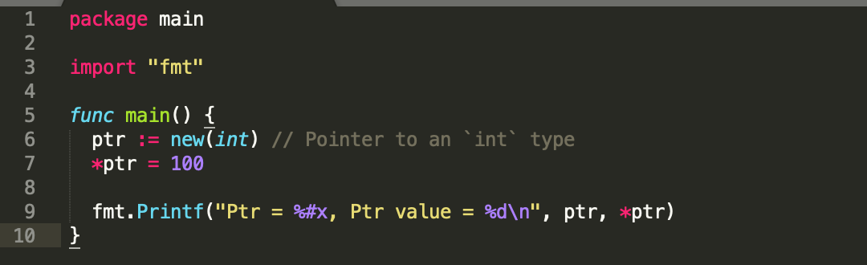

Let’s try
Guess it what output it is

Slide 11
Struct

Slide 12
Struct
A struct is a user-defined type that contains a collection of named fields/properties
It is used to group related data together to form a single unit

Slide 13
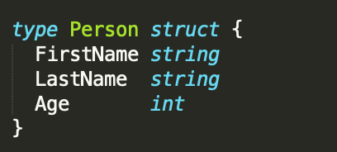
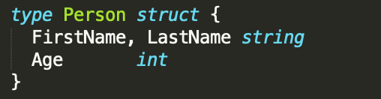
Struct - Defining

Slide 14

Struct - Declaration & Initialization
Note: You need to pass the field values in the same order in which they are declared in the struct

Slide 15
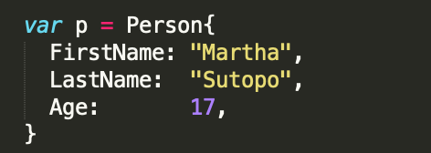
Struct - Initialization
Also you can name it while initializing a struct
You can separate multiple fields by new line

Slide 16
Struct - Initialization
Note: The name: value syntax allows you to initialize only a subset of fields. All the uninitialized fields are set to their corresponding zero value

Slide 17
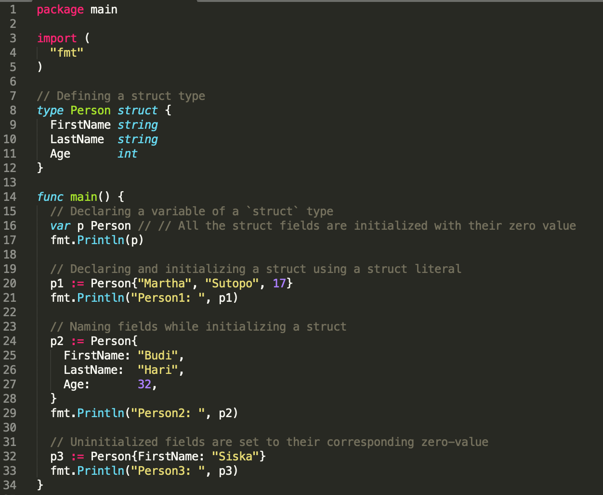
Struct

Slide 18
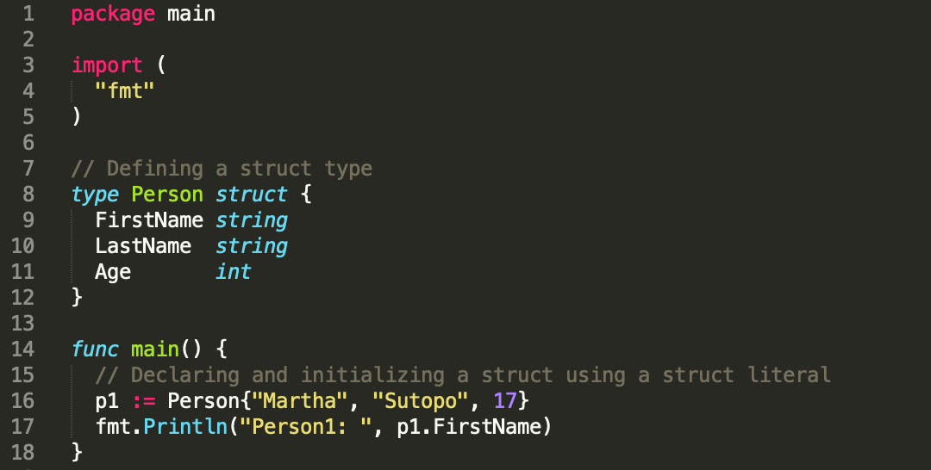
Struct – Accessing field
You can access individual fields of a struct using the dot (.) operator

Slide 19
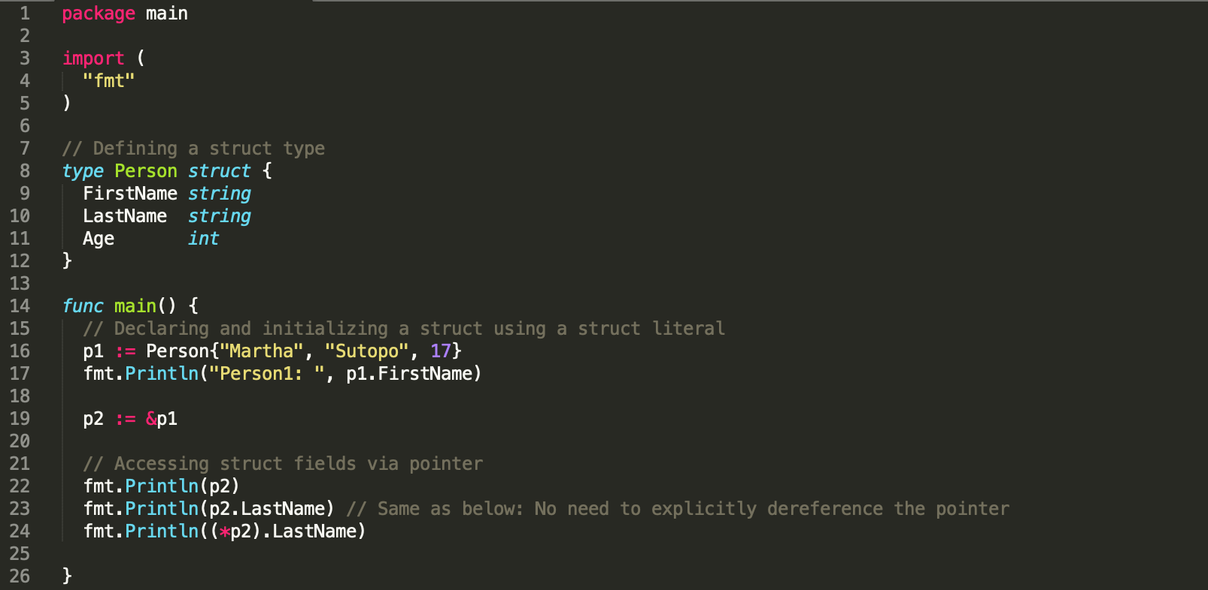
Let’s try
Guess it what output it is

Slide 20
Method

Slide 21
Method
A method is nothing but a function with a special receiver argument.
The receiver argument has a name and a type. It appears between the func keyword and the method name.
The receiver can be either a struct type or a non-struct type.

Slide 22
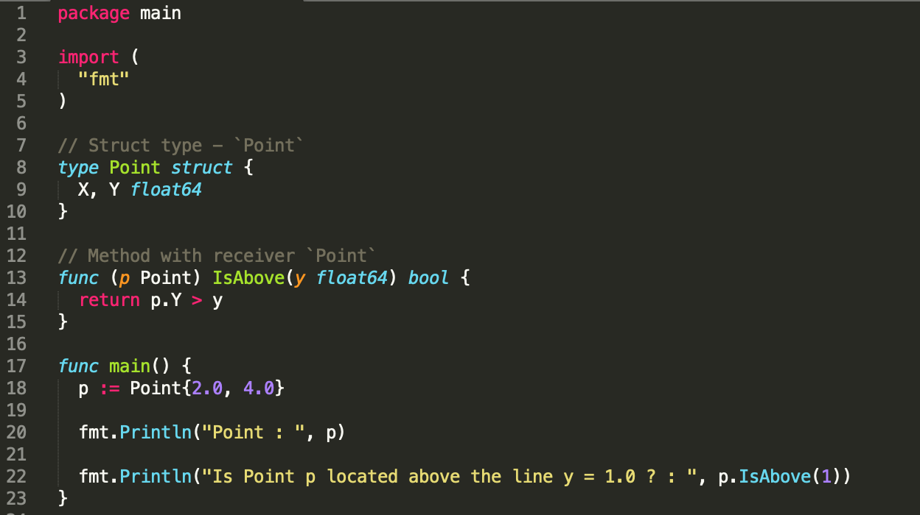
Method

Slide 23
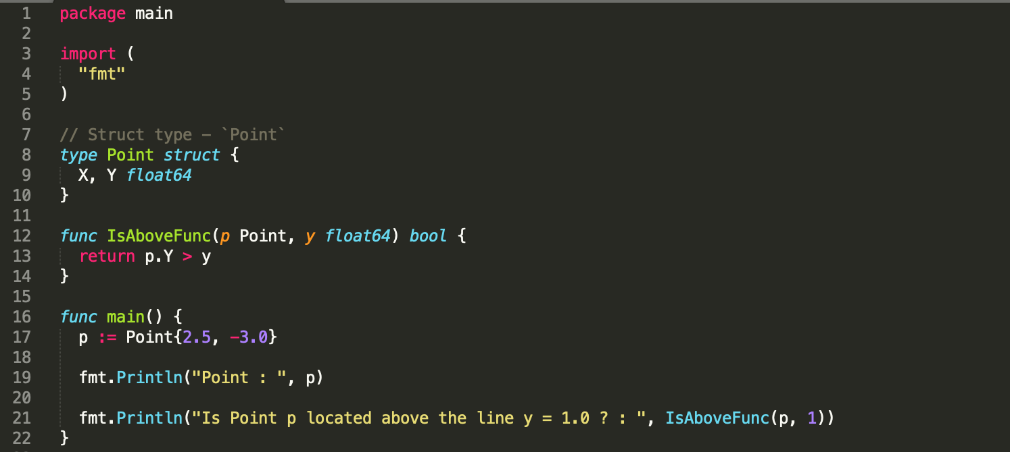
Method - Function

Slide 24
Why Methods instead of Functions?
Methods help you write object-oriented style code in Go
Method calls are much easier to read and understand than function calls
Methods help you avoid naming conflicts
you can have the same method names on different receiver types.

Slide 25
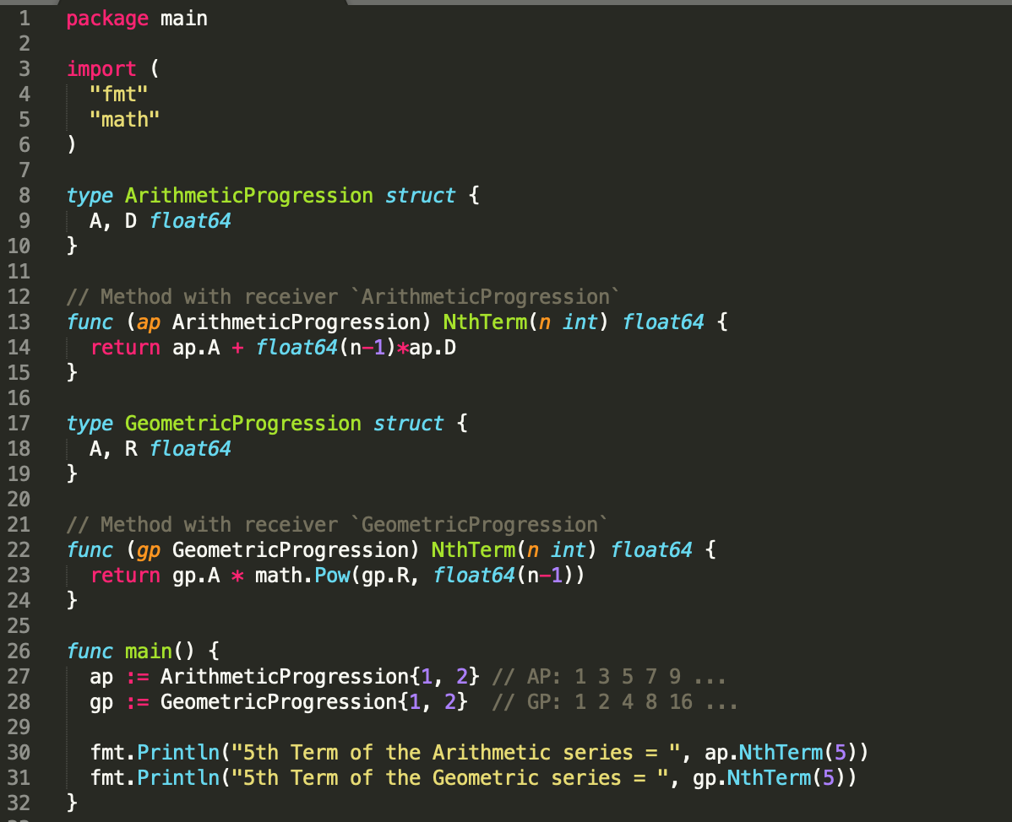
Method instead of Function

Slide 26
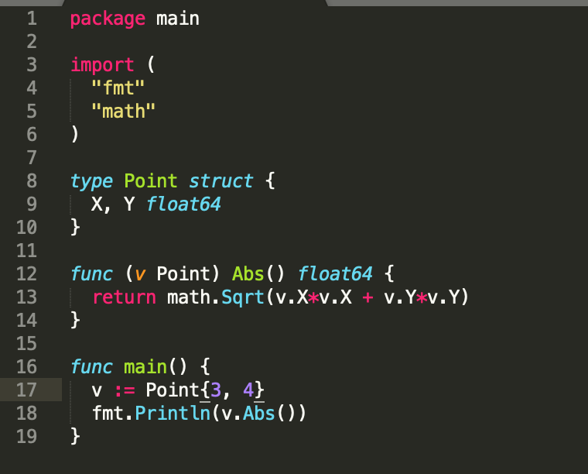
Let’s try
Guess it what output it is

Slide 27
Summary
Pointer
Struct
Method

Slide 28


